Slide 1
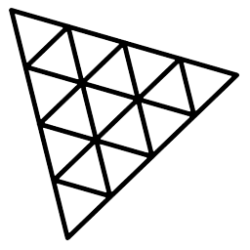
Three.js
3.JS
is
awesome
GUIDE FOR BEGINNERS
PROJECT PROPOSAL

Slide 2
TOPIC 15:
ABOUT
BUDGET
PROJECT
TIMELINE
SHADOWS
PROJECT PROPOSAL

Slide 3
HOW SHADOW WORKS
TABLE OF CONTENTS
BASIC SCENE WITH SHADOW
LIGHTS CASTING SHADOW
How shadow works
Basic scene with shadow
Lights casting shadow
01
02
03
PROJECT PROPOSAL

Slide 4

What is material
How shadow works
Basic scene with shadow
Lights casting shadow
01

Slide 5
How shadow works
Basic scene with shadow
Lights casting shadow
The Three.js casts shadow using shadow map.
Shadow Map: A process in which, for every light that casts shadows are rendered from the point of view of light.
In simple words, we render from the light’s point of view and every thing we see from the light’s perspective is lit. So anything we cant see must be in shadow.

Slide 6

Basic Scene with Shadow
How shadow works
Basic scene with shadow
Lights casting shadow
02

Slide 7
How shadow works
Basic scene with shadow
Lights casting shadow
const canvas=document.getElementById('webgl3');
const scene=new THREE.Scene();
const camera=new THREE.PerspectiveCamera(50,window.innerWidth/window.innerHeight,1,1000)
scene.add(camera)
camera.position.set(0,-8,20)
const renderer=new THREE.WebGLRenderer({canvas:canvas})
renderer.setSize(window.innerWidth,window.innerHeight)
renderer.shadowMap.enabled=true;
renderer.render(scene,camera)
const directionalLight = new THREE.DirectionalLight(0xfffffff, 1)
scene.add(directionalLight)
directionalLight.position.z=8;
scene.add(new DirectionalLightHelper(directionalLight))
light.castShadow=true
const plane=new THREE.Mesh(new THREE.PlaneGeometry(10,10), new THREE.MeshStandardMaterial())
scene.add(plane)
plane.rotation.z=-4
plane.position.z=-4
plane.receiveShadow=true;
const sphere=new THREE.Mesh(new THREE.SphereGeometry(1), new THREE.MeshBasicMaterial())
sphere.position.set(0,-2,1)
scene.add(sphere)
sphere.position.set(0,0,4)
sphere.castShadow=true;

Slide 8
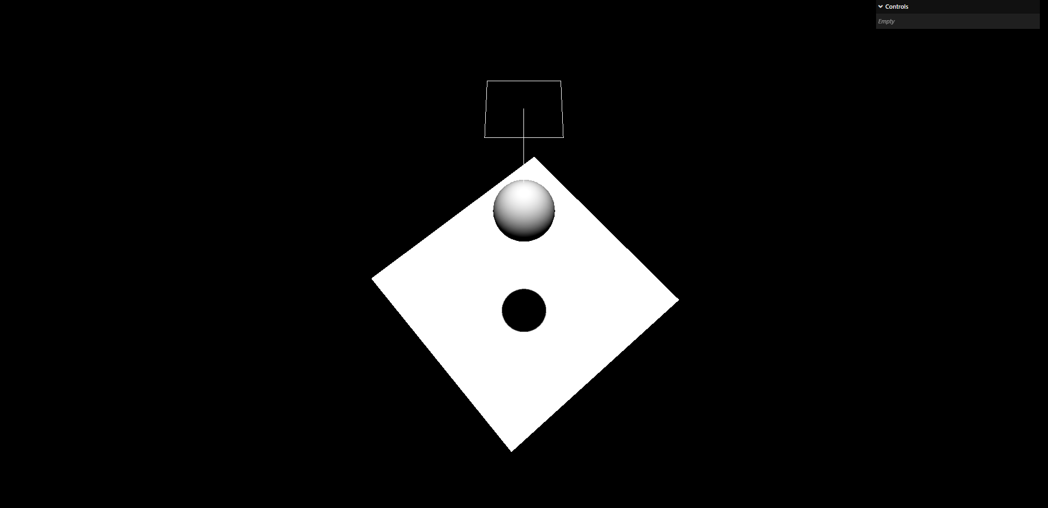
How shadow works
Basic scene with shadow
Lights casting shadow

Slide 9
Lights Casting Shadow
How shadow works
Basic scene with shadow
Lights casting shadow
03

Slide 10
How shadow works
Basic scene with shadow
Lights casting shadow
The lights that casts shadow;
1. Directional Lights
2. Point Lights
3. Spot Lights
The lights that don’t casts shadow;
1. Hemisphere Lights
2. Ambient Lights
3. RectArea Lights

Slide 11
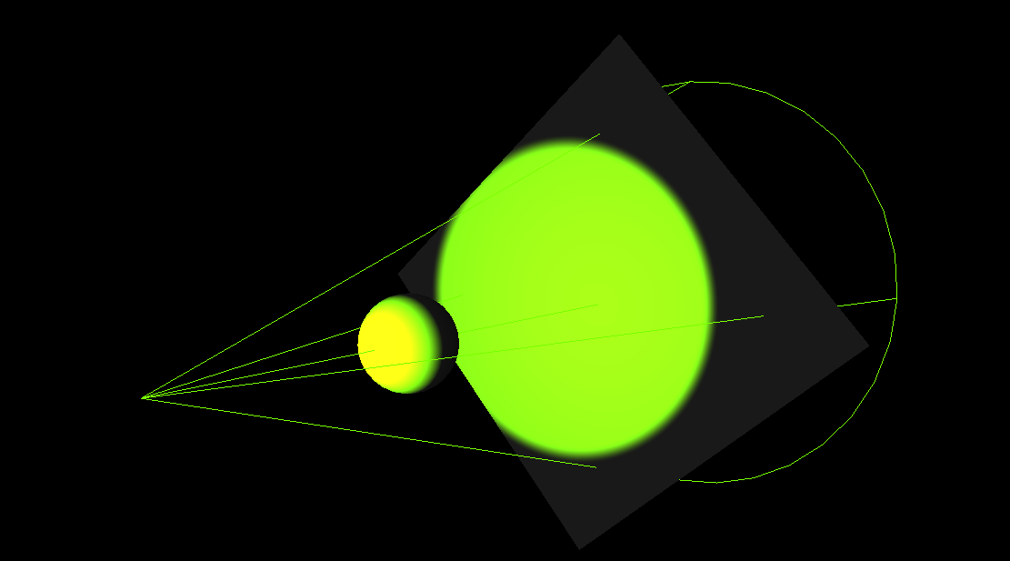
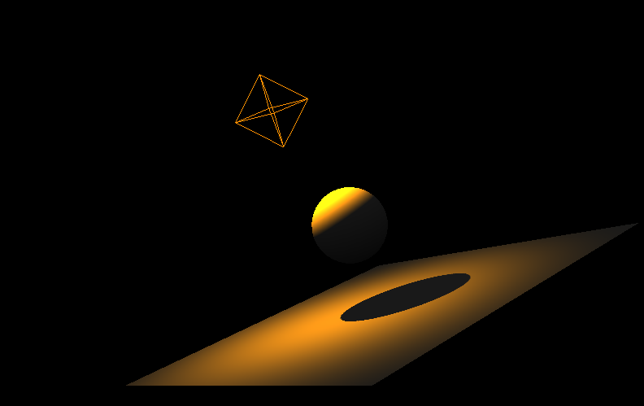
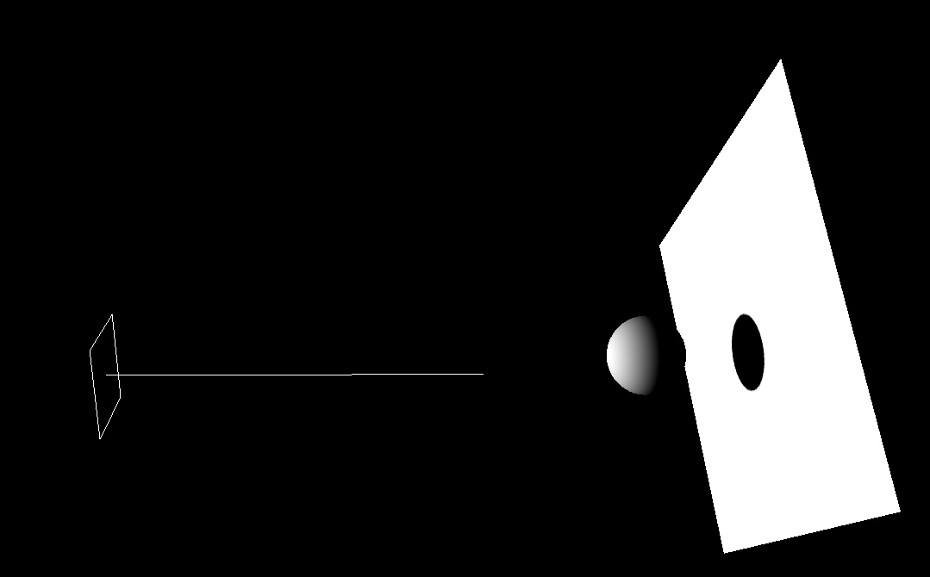
How shadow works
Basic scene with shadow
Lights casting shadow
SpotLight PointLight HemisphereLight

Slide 12
THANKS!
ABOUT
BUDGET
PROJECT
TIMELINE
Do you have any questions?
EMAIL: aadnanshahh2001@gmail.com
GITHUB: https://github.com/AdnanShahSahb
Please keep this slide for attribution
PROJECT PROPOSAL

